Slide 1

Correlation between
numerical features
DATA ANALYTICS | IRONHACK

Slide 2

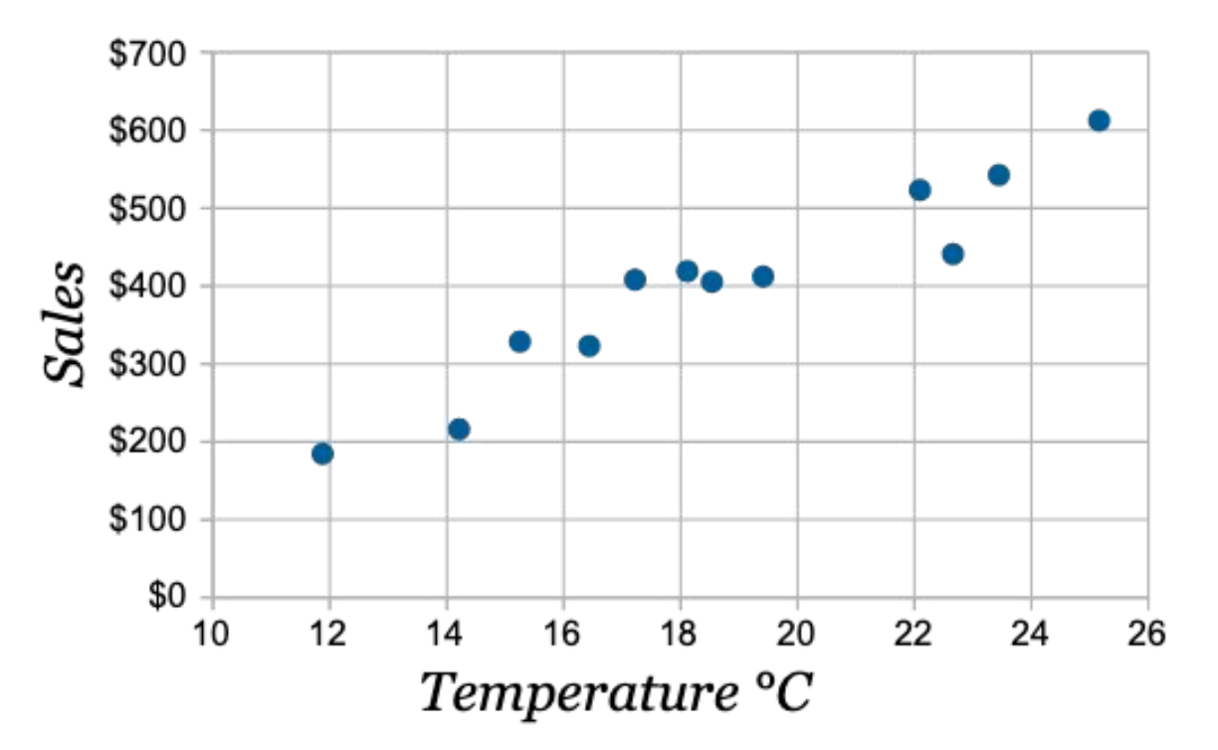
IRONHACK BOOTCAMP
LINEAR CORRELATION EXAMPLE

Slide 3
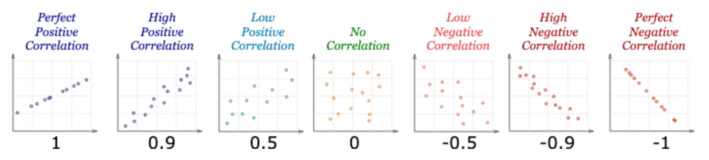
Ideal correlation shows a linear straight line
IRONHACK BOOTCAMP
LINEAR CORRELATION (Pearson correlation)
The correlations quantifies how much linearly related two numerical variables are. For categorical we use sth else.
The correlation coefficient can be positive, negative or null
The range of values is: -1, 1
Correlation doesn’t imply causation

Slide 4
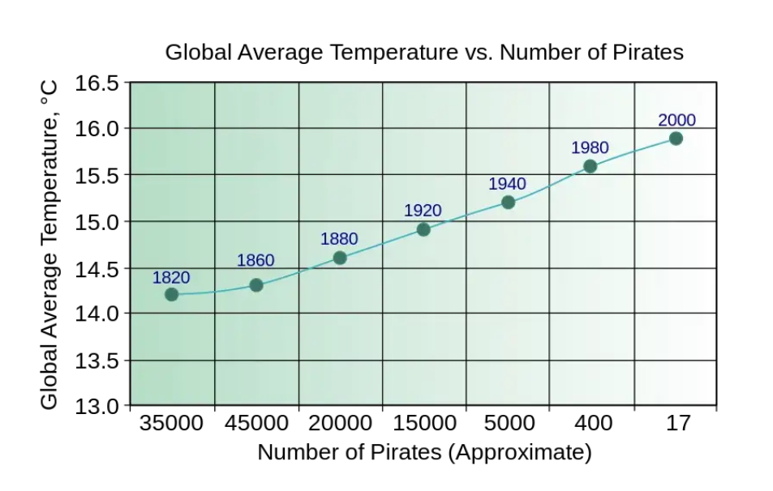

Slide 5
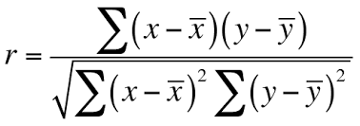
IRONHACK BOOTCAMP
QUANTIFYING LINEAR CORRELATION
The correlation is given by: two variables

Slide 6
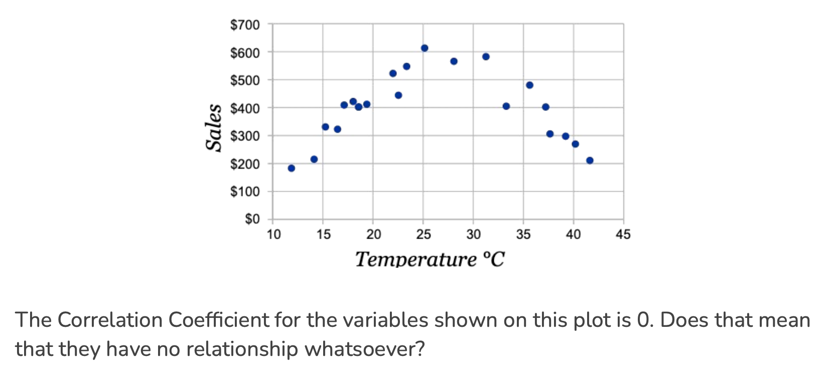
IRONHACK BOOTCAMP
LACK OF LINEAR CORRELATION(Pearson) DOESN’T MEAN LACK OF RELATIONSHIP!
Non-linear
Correlation

Slide 7
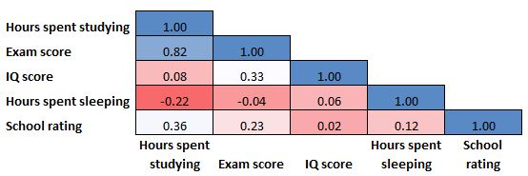
IRONHACK BOOTCAMP
Correlation Heatmap

Slide 8


